Slide 1

Build Your First Website with Flask from Scratch!
Presenter：QiYiyu LingJiali
ShiYuhan
ChangYueyu
Reporting Time：2025/10/21

Slide 2

01.
03.
05.
First Impressions of Flask
02.
04.
Practical code
Summary ,Quick Reference
Core components
Deployment and Scaling
CONTENTS

Slide 3
01
First Impressions of Flask

Slide 4
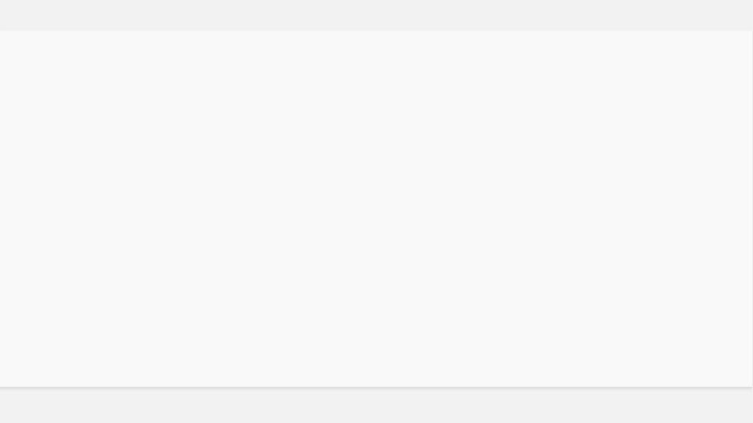
What is Flask?
The lightest web framework in the Python community, making development simple and elegant.
Microframework
Double-layer standard
Beginner-friendly

Slide 5
5 lines of code, launch your first website
2. Creat app.py
from flask import Flask
app = Flask(__name__)
@app.route('/')
def index():
return 'Hello, Flask!'
app.run()
1. Install Flask
pip install flask
Run python app.py and visit 127.0.0.1:5000.

Slide 6
02
Core components

Slide 7
Routing: The website's “URL mapping table”
Use the @app.route decorator to bind a function to a URL.
Static Routing
Dynamic Routing
The path is fixed.
+
The path contains variable parts.
@app.route('/about')
@app.route('/user/')
Using syntax, URL segments can be converted into function parameters to enable personalized responses.

Slide 8
Template Example Template Example(list.html)
Generate pages using Jinja2 templates
{% for item in items %}
{{ item }} {% endfor %}
Directly returning strings makes it difficult to maintain HTML structure. Flask's built-in Jinja2 engine allows Python variables to be easily embedded within HTML tags.
Render call
return render_template('list.html', items=my_list)

Slide 9
Retrieve data sent by the browser
`request`
request.args
request.form
request.json
Retrieve the URL query string (GET request).
Retrieve JSON data from an Ajax request.
Retrieve form data submitted via POST.
/search?q=flask
fetch('/api', {method: 'POST'})

Slide 10
Redirects and Session Persistence
After form submission, use `redirect()` to redirect the user to prevent duplicate submissions caused by page refreshes. Utilize the `session` object to maintain user state across requests.
1.Set the key:
app.secret_key = '...'
User login
Set Session
Go to the backend
2. Write a conversation:
session['user'] = username
3. Jump to Page:
return redirect(url_for('admin'))

Slide 11
03
Practical code

Slide 12
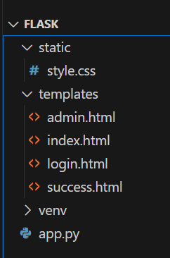
Project Directory Structure
Following Flask's default conventions, the structure is clear and requires no additional configuration.
Project root directory
Tree
my_flask_app/ ├── app.py ├── static/ │ └── style.css ├── templates/ │ ├── index.html │ ├── login.html │ ├── admin.html │ └── success.html └── requirements.txt
app.py (Main Program)
static/ (Static files)
templates/ (Template File)
requirements.txt (Dependency)

Slide 13
Practical Application: Data Flow for Student Sign-In Page
From form submission to list display, a complete data processing cycle.
3. Page reload
Rendering Template
4. List of Exhibitors
Rotating Display
1. Form Submission
POST request
2. Backend Processing
Update Dictionary

Slide 14
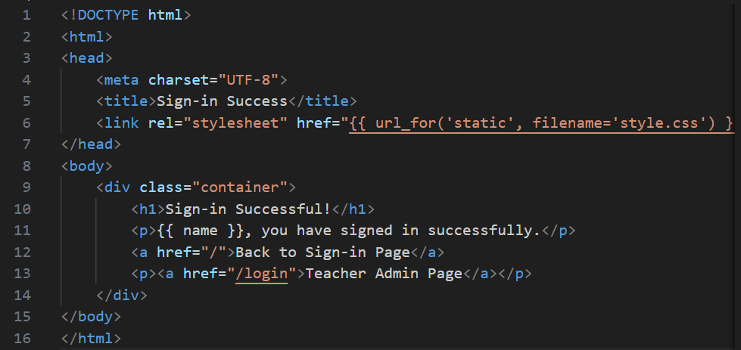
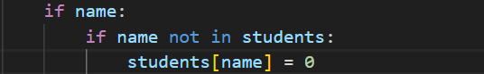
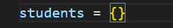
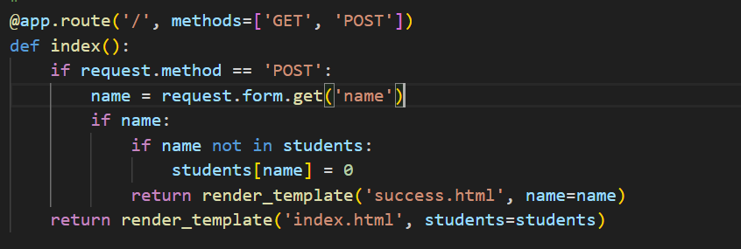
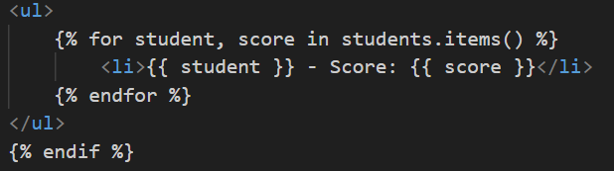
Student Sign-In Page
Core Logic
success.html
app.py

Slide 15
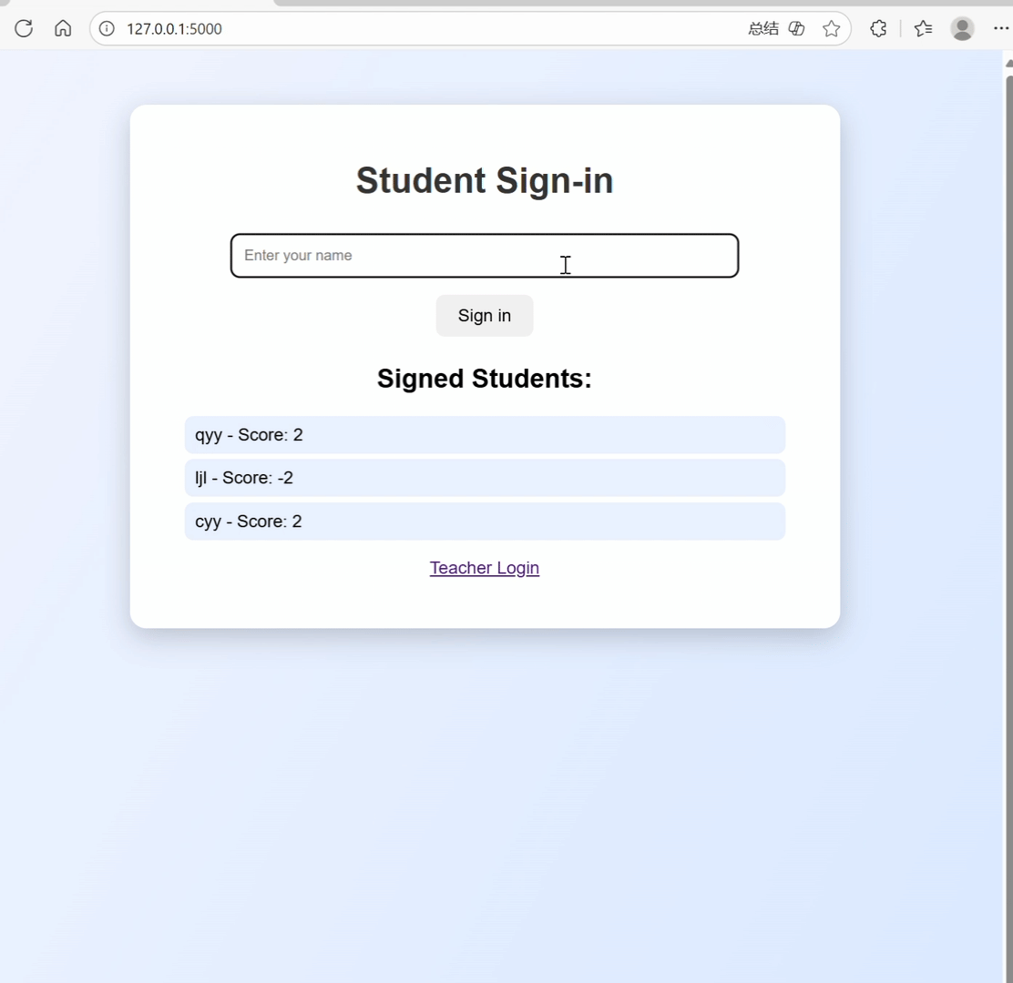
Functionality Demo (Student Edition)

Slide 16
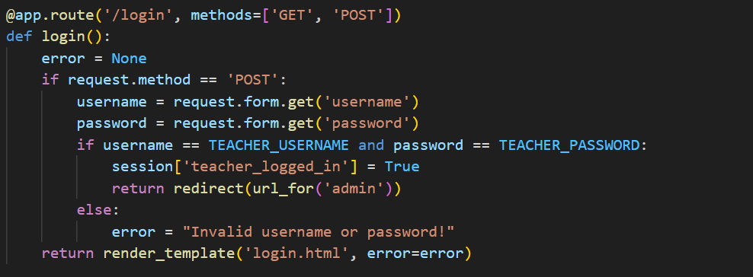
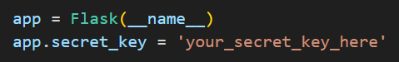
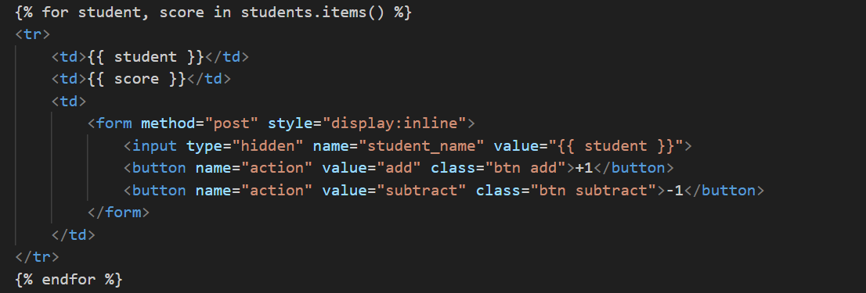
Backend (Teacher Portal): Login Interception and Table Rendering
Login Interception
Table Rendering
app.py

Slide 17
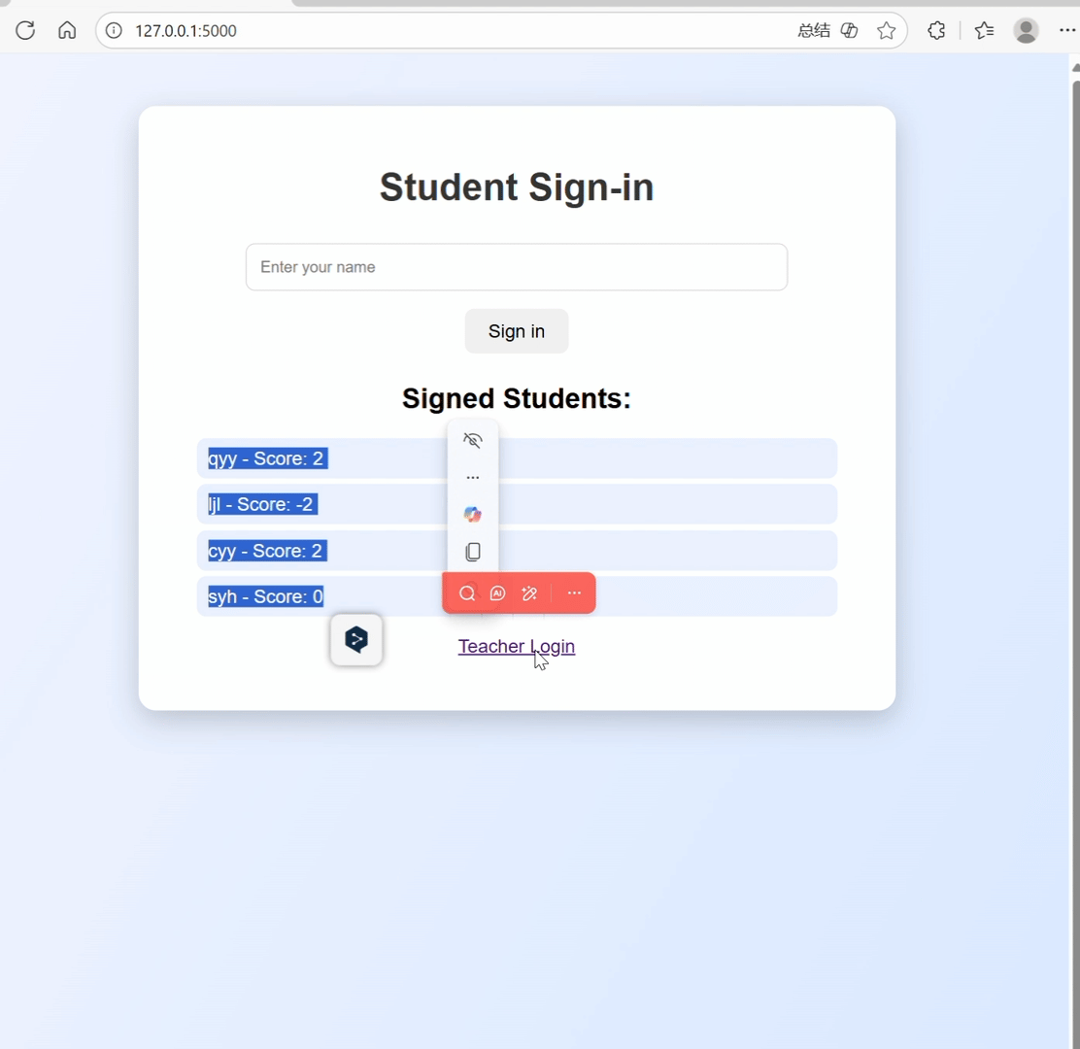
Feature Demo (Teacher Edition)

Slide 18
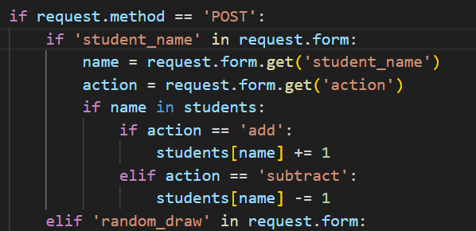
Backend: Bonus/Penalty Points and Random Roll Call
Bonus/Penalty Points Feature
Note: All current states are stored in the in-memory dictionary. Data will be lost after restarting the service.

Slide 19
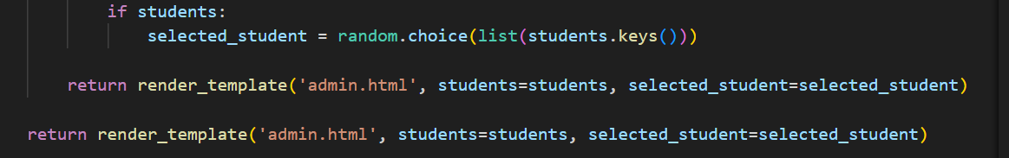
Backend: Bonus/Penalty Points and Random Roll Call
Random Roll Call Feature
Note: All current states are stored in the in-memory dictionary. Data will be lost after restarting the service.

Slide 20
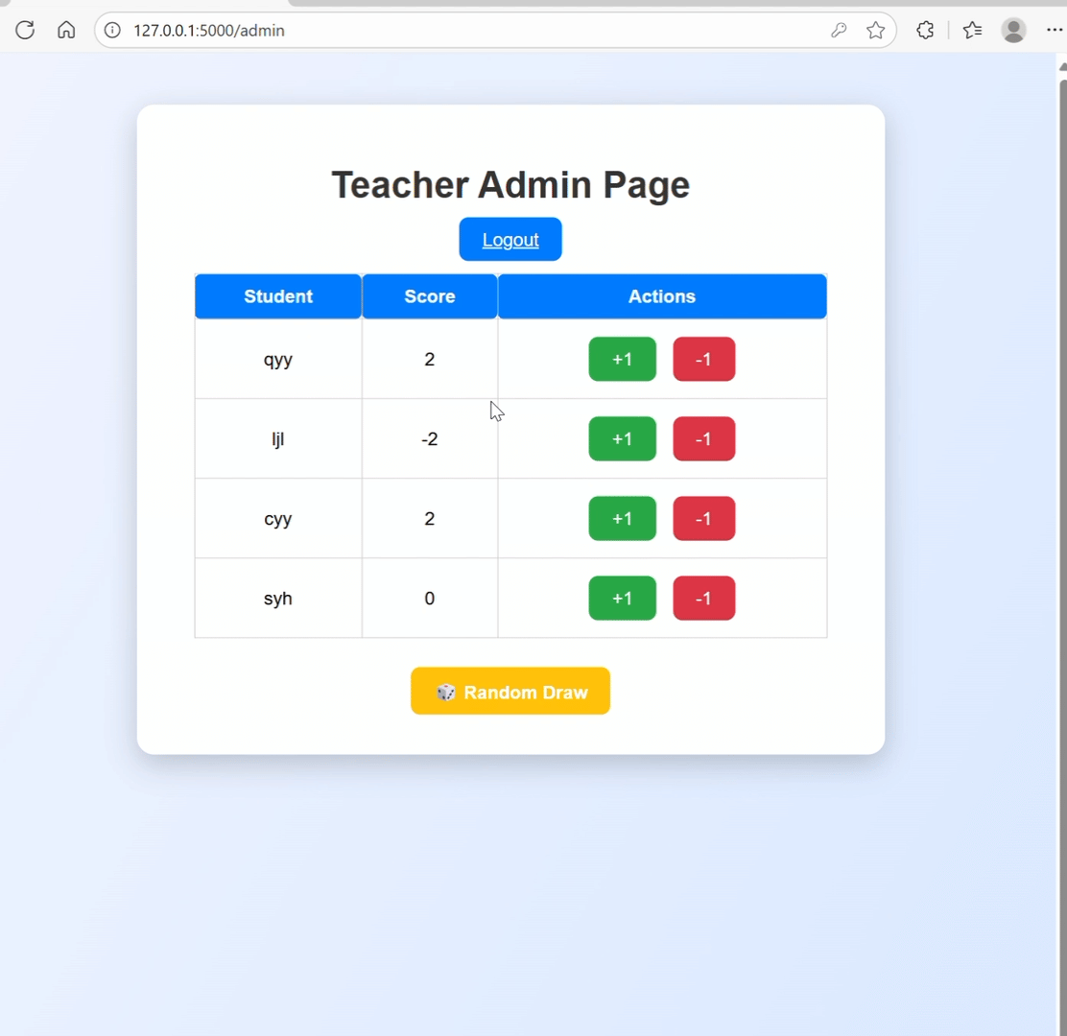
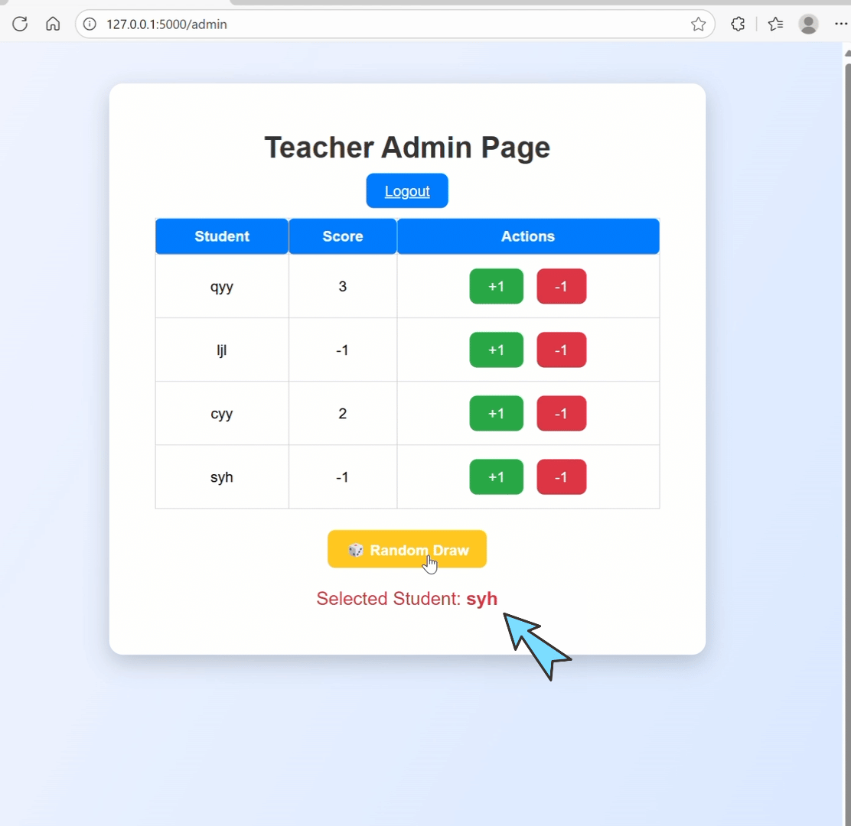
Feature Demo (Points Addition/Subtraction & Random Roll Call)

Slide 21
04
Deployment and Scaling

Slide 22
How does the production environment operate?
Production Environment Startup Command
# use Waitress (Cross-platform) pip install waitress waitress-serve --port=5000 app:app # use Gunicorn (Unix-like) pip install gunicorn gunicorn --bind 0.0.0.0:5000 app:app
During development, use `app.run(debug=True)` for convenient debugging, but a more stable approach is required for production deployment.
Using a WSGI server
Such as Waitress or Gunicorn, which offer superior performance. Commands like gunicorn app:app .
Security Settings
Disable debug mode and set a randomly generated, complex SECRET_KEY.

Slide 23
Next Step: Scalable Directions
Flask boasts a rich ecosystem of plugins, empowering your applications with new capabilities.
Data Persistence
User Authentication
Asynchronous Interaction

Slide 24
05
Summary ,Quick Reference

Slide 25
In 5 minutes, replicate an entire website.
From zero to an accessible site in just four steps.
1. Installation
2. compilation
3. Run
4. Visit
pip install flask
Create app.py and templates
python app.py
Open your browser
Hands-on learning is the best way to learn. Start your Flask journey today!

Slide 26
Flask Core API Quick Reference Guide
from flask import Flask
@app.route('/')
app = Flask(__name__)
request.args / .form
render_template('index.html')
redirect(url_for('admin'))
session['user'] = 'admin'
flash('Operation successful!')
app.run(debug=True)

Slide 27
06
Q＆A

Slide 28

Thank you for watching.
Presenter：QiYiyu LingJiali
ShiYuhan
ChangYueyu
Reporting Time：2025/10/21

